Slide 1
Introducing XNA for WP7
Rob Fonseca-Ensor
Notes:
http://www.youtube.com/watch?v=I_U7YZwf2Nw
http://www.youtube.com/watch?v=ycli-koDlP8

Slide 2

Me
I help run the CWDNUG
I’m co-authoring a WROX book on WP7
I’ve got an iPhone game on the app store
I write Silverlight apps ALL DAY LONG (for Infusion)
www.robfe.com | rob@robfe.com | @robfe | meetup.com/cwdnug

Slide 3
What is it
.NET framework for games
  XBOX, PC, Zune
  Now WP7
Creator’s Club
  http://creators.xna.com
Parallel set of .NET APIs
  Even more cut down on WP7
Relatively Portable

Slide 4
When to use it
Silverlight is event driven
  It reacts to the user
  Suitable for some games
XNA is a game loop
  The user reacts to the game
3D graphics
Performance

Slide 5
Running an XNA game
LoadContent
Game Loop
UnloadContent (Theoretically)
Initialize
Draw
Update
Notes:
Update is responsible for reading the state of the user input, network input and mutating the game state
Draw is responsible for reading the game state and rendering that to the screen

Slide 6
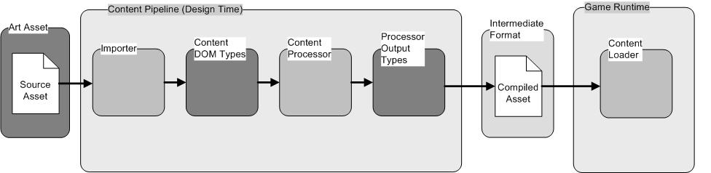
The Content Pipeline
http://msdn.microsoft.com/en-us/library/bb447745.aspx
Notes:
The content pipeline represents a huge boost in runtime-performance, portability and ease of development
It can take your fonts, and only include the glyphs you’d like. Images and sounds are compressed and optimised for the target device.
3D assets will be processed appropriately

Slide 7
2D drawing with the SpriteBatch
A class that manages the rendering of 2D sprites (textures) and fonts
Begin
  Starts a batch
Draw
  Paints a Texture2D to the screen
DrawString
  Paints a SpriteFont + a string to the screen
End
  Commit the batch

Slide 8
As time goes by
Track how quickly by inspecting the GameTime
  Allows proportional movement
    Ever tried to play a 286 game on a 66 MHz beast?
React to time passing within Update
  Update is less likely to skip than Draw
  You don’t want to miss a poll of some user input

Slide 9
Geometry APIs
Vector2
  + - * / another Vector2 or a float.
  Normalize, Length, LengthSquared
System.Math
  Math.ATan2(x,y) to calculate angles
  Cos and Sin to turn an angle into a Vector2
MathHelper
  The XNA Version of System.Math
  Constants: PI, TwoPi, PiOverFour, E, Log10E
  Methods: DegreesToRadians, Clamp, CatMullRom, Lerp

Slide 10
Reading User Input
GamePad
  An XBOX relic
  Check if the user is pressing “back” (exit or menu)
TouchPanel
  GetState()
    Picks up all the currently touched points
    Each touch has an ID
  ReadGesture()
    Higher level API
    Filter with EnabledGestures

Slide 11
Encapsulation with GameComponent
Update or Draw will get bigger as your game gets built
Separate responsibilities into components
  Don’t treat these as sprites – they should be long-lived
Share state via Game.Services
GameComponent has parallel Initialize, LoadComponent, Update and Draw (DrawableGameComponent)

Slide 12
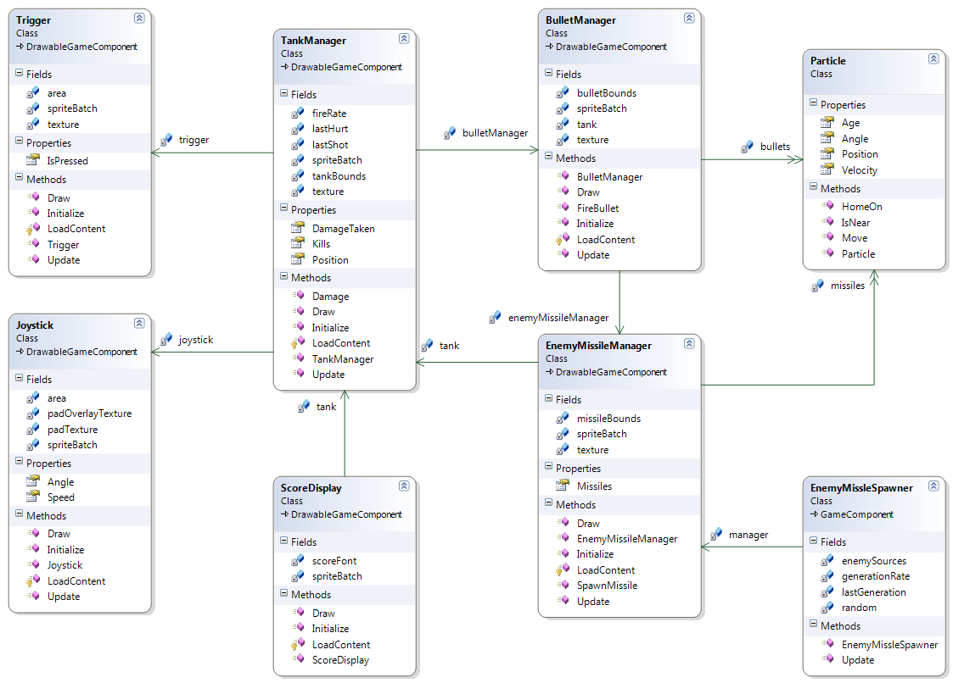
Notes:
My GameComponents, let me show you them

Slide 13
Questions?
www.robfe.com | rob@robfe.com | @robfe | meetup.com/cwdnug

